Slide 1
IMAGE ADAPTOR
CHAPTER SEVEN

Slide 2
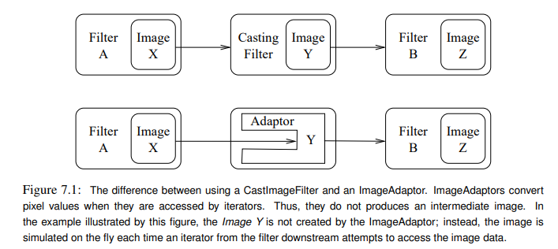
Image Casting Vs Image Adaptors

Slide 3
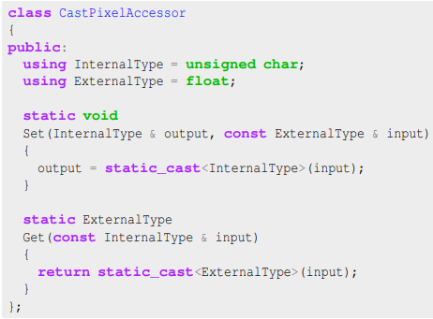
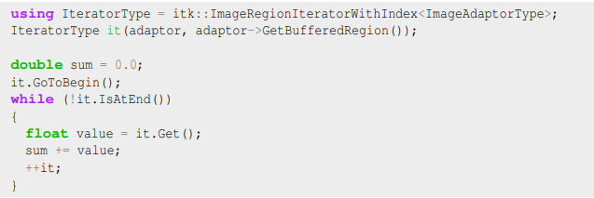
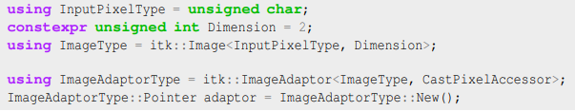
example

